Slide 1
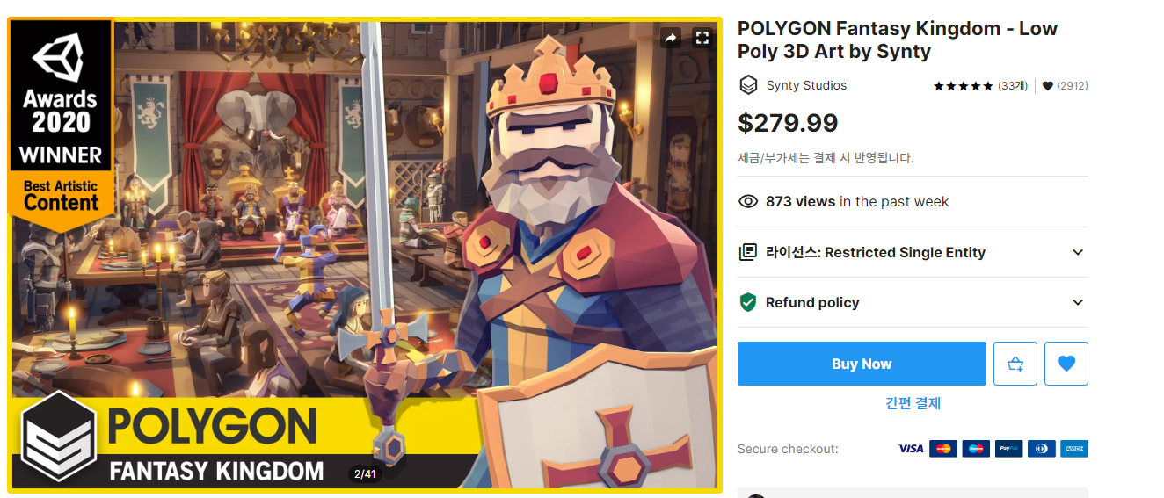
마을, 야생, 캐릭터
https://assetstore.unity.com/packages/3d/environments/fantasy/polygon-fantasy-kingdom-low-poly-3d-art-by-synty-164532

Slide 2
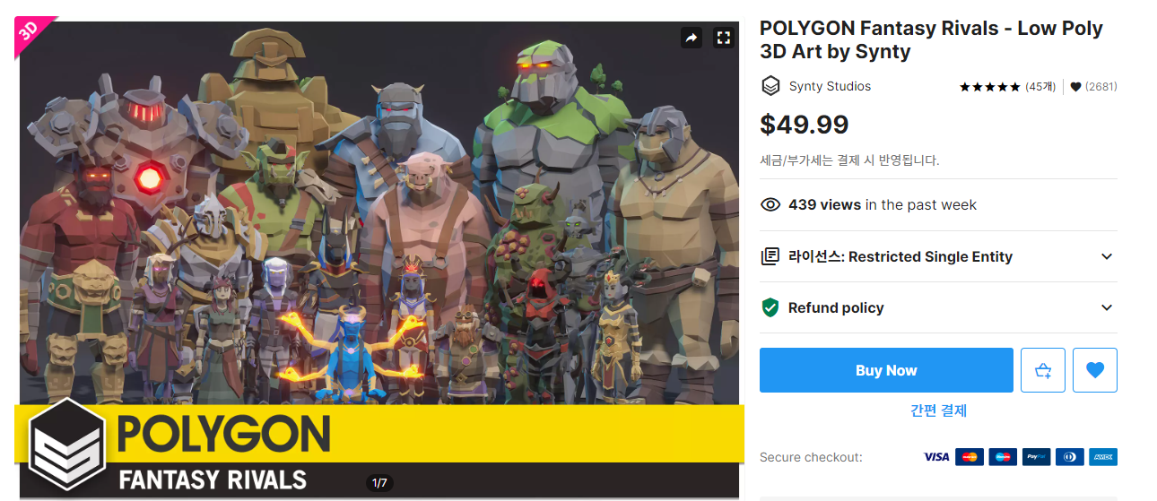
몬스터
https://assetstore.unity.com/packages/3d/characters/humanoids/fantasy/polygon-fantasy-rivals-low-poly-3d-art-by-synty-118399

Slide 3
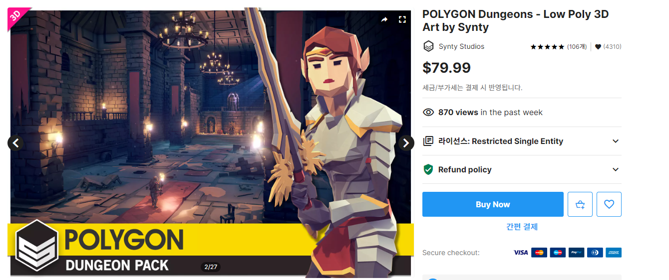
광산, 던전
https://assetstore.unity.com/packages/3d/environments/dungeons/polygon-dungeons-low-poly-3d-art-by-synty-102677#content

Slide 4
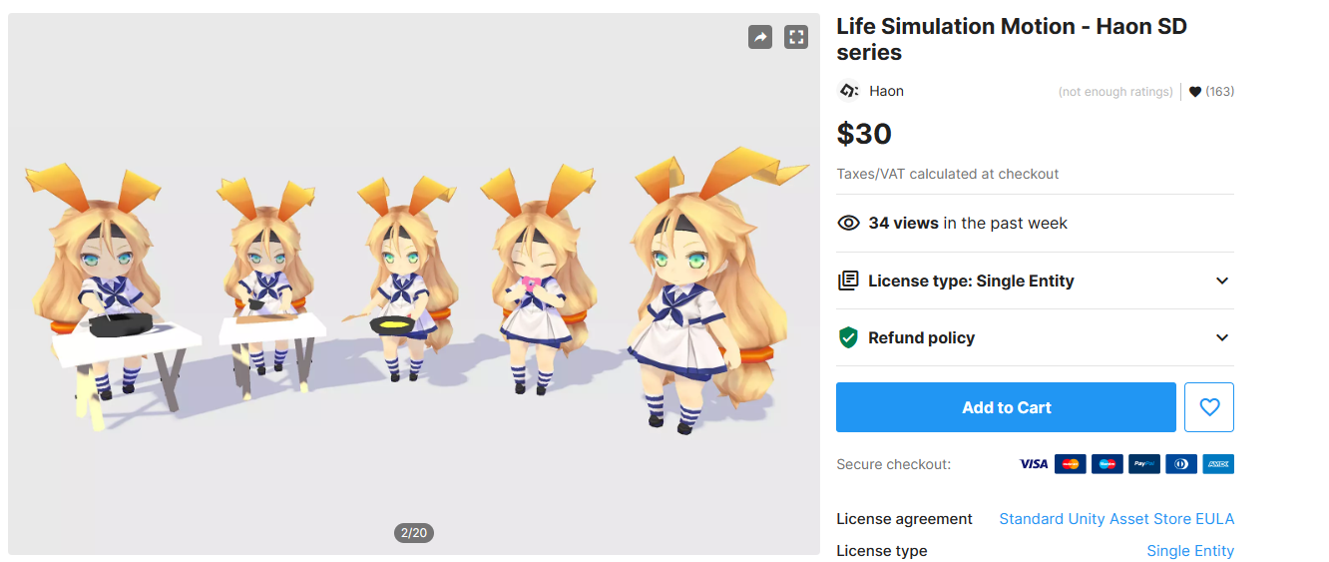
애니메이션(구매 완료)
https://assetstore.unity.com/packages/3d/animations/life-simulation-motion-haon-sd-series-106560

